Slide 1
网络安全原理与实践
林峰
2024年春季学期

Slide 2
Lecture 6-1
PKI and Digital Certificate
林峰
flin@zju.edu.cn

Slide 3
Background
Public key cryptography uses two keys
  one that is secret to the “owner”
  one that is widely available
And all our problems were solved?
  There is still a problem of Authentication!
    Who ensures that the owner of a key pair is really the person whose real life name is “Alice”?
Intranet
Extranet
Internet
Moving towards PKI …
Bob
Alice
Notes:
Bob和Alice生成各自的一对公/私钥，各自保存私钥，借助网络把公钥发送给对方。
Bob用Alice的公钥加密一个文件并发送给Alice。
Alice用私钥解密文件，获得原始文件
问题：如果入侵者监视Bob和Alice的网络通信信道并用自己的公钥替换Alice的公钥 ! ……
解决方案：采用基于可信第三方的PKI

Slide 4
Solution: Contact someone already trust to certify that the key really belongs to real owner (PKI).
Public key infrastructure is an infrastructure to support and manage Public Key-based Digital Certificates.
A Digital Certificate is a binding between an entity’s Public Key and one or more Attributes relating its Identity.

Slide 5
Functions and Components of PKI
Basic Components:
Certificate Authority (CA)
Registration Authority (RA)
Certificate Distribution System
PKI enabled applications
“Provider” Side
“Consumer” Side

Slide 6
A Simple PKI Model
Certification
Entity
CA
Cert. Request
Application
Service
RA
Signed Certificate
Internet
Certs,
CRLs
Directory
Remote
Person
Local
Person

Slide 7
Functions and Components of PKI
(1) Certificate Authority (CA)
A trusted third party - must be a secure server
Signs and publishes Identity certificates
Revokes certificates and publishes a Certification Revocation List (CRL)
Many vendors
  OpenSSL - open source, very simple
  Netscape - free for limited number of certificates
  Entrust - Can be run by enterprise or by Entrust
  RSA Security - Keon servers
Notes:
CA也称数字证书认证中心(认证中心)，作为具有权威性、公正性的第三方可信任机构，是PKI体系的核心构件。
CA负责发放和管理数字证书。

Slide 8
Functions and Components of PKI
Functions of Certificate Authority (CA)
Key Generation
Digital Certificate Generation
Certificate Issuance and Distribution
Revocation
Key Backup and Recovery System
Cross-Certification
Notes:
CA提供网络身份认证服务、负责证书签发及签发后证书生命周期中的所有方面的管理，包括跟踪证书状态且在证书需要撤销(吊销)时发布证书撤销通知。CA还需维护证书档案和证书相关的审计，以保障后续验证需求。

Slide 9
Functions and Components of PKI
(2) Registration Authority(RA)
A registration authority is the PKI component that accepts a request for a digital certificate and performs the necessary steps of registering and authenticating the person requesting the certificate.
The authentication requirements differ depending on the type of certificate being requested.
RA verifies identity for CA. CA issues certificate.
Notes:
注册机构(也称注册中心)是数字证书注册审批机构，与CA在逻辑上是一个整体，执行不同的功能。
RA负责对证书申请进行资格审查。
The Registration Authority (RA) verifies certificate contents for the CA.
The RA collects the identifying information and sends it to the CA.
RAs are usually operated by a single person, whereas a CA is larger and has many people
Each CA maintains a list of trusted and accredited RAs
The RA is known to the CA by a name and public key (i.e. the RA has a certificate of it’s own that
identifies it with it’s public key).
That CA can verify the RA's signature, to be sure that the information obtained is reliable.
Like CAs, RAs must provide adequate protection for their private keys.
So, the RA verifies the identity of the certificate requestor on behalf of the CA. Then, the CA generates
the certificate using information forwarded by the RA.

Slide 10
Functions and Components of PKI
Functions of Registration Authority(RA)
Registration of Certificate Information
Face-to-Face Registration
Remote Registration
Automatic Registration
Revocation
Notes:
其主要功能如下
(1)填写用户注册信息：替用户填写有关用户证书申请信息。
(2)提交用户注册信息：核对用户申请信息，决定是否提交审核。
(3)审核：对用户的申请进行审核，决定“批准”还是“拒绝”用户的证书申请。
(4)发送生成证书申请：向CA提交生成证书请求。
(5)发放证书：将用户证书和私钥发放给用户。
(6)登记黑名单：对过期的证书和撤销的证书及时登记，并向CA发送。
(7)证书撤销列表管理：确保CRL的及时性，并对CRL进行管理。
(8)日志审计：维护RA的操作日志。
(9)自身安全保证：保障服务器自身密钥数据库信息、相关配置文件安全。

Slide 11
Functions and Components of PKI
(3) Certificate Distribution System
Provide Repository for:
Digital Certificates
Certificate Revocation Lists (CRLs)
Typically:
Special Purposes Databases
LDAP directories
Notes:
证书发布库集中存放CA颁发的证书和证书撤销列表(CRL，Certificate Revocation List)。
证书库是网上可供公众进行开放式查询的公共信息库。公众查询目的通常有两个：①得到与之通信的实体的公钥；②验证通信对方的证书是否在“黑名单”中。

Slide 12
Functions and Components of PKI
(4) Key Backup And Recovery
The only keys requiring backup are users' decryption keys. However, signing keys have different requirements from decryption keys. The signing key be generated and securely stored in a manner under the sole control of the user at all times. It is not acceptable to back up the signing key.
Notes:
针对用户密钥丢失的情形，PKI提供密钥备份与恢复机制。密钥备份和恢复只能针对加／解密密钥，而无法对签名密钥进行备份。数字签名是用于支持不可否认服务的，有时间性要求，因此不能备份／恢复签名密钥。
密钥备份在用户申请证书阶段进行，如果注册声明公／私钥对是用于数据加密的，则 CA即可对该用户的私钥进行备份。当用户丢失密钥后，可通过可信任的密钥恢复中心或CA完成密钥恢复。

Slide 13
Functions and Components of PKI
(5) Certificate Revocation
The application software must also be sure that the certificate is trustworthy at the time of use. Certificates that are no longer trustworthy must be revoked by the CA.
The popular means
  Certificate Revocation Lists (CRLs)
  Online Certificate Status Protocol (OCSP)
Notes:
证书由于某些原因需要作废时，如用户身份姓名的改变、私钥被窃或泄露、用户与所属企业关系变更等，PKI需要使用一种方法警告其他用户不要再使用该用户的公钥证书，这种警告机制被称为证书撤销。
证书撤销的主要实现方法有以下两种。
1)利用周期性发布机制，如证书撤销列表(CRL，Certificate Revocation List)。证书撤销消息的更新和发布频率非常重要，两次证书撤销信息发布之间的间隔称为撤销延迟。在特定PKI系统中，撤销延迟必须遵循相应的策略要求。
2)在线查询机制，如在线证书状态协议(OCSP，Online Certificate Status Protocol)。

Slide 14
Certificate Revocation List
CRLs are published by CAs at well defined interval of time
It is a responsibility of “Users” of certificates to “download” a CRL and verify if a certificate has been revoked
User application must deal with the revocation processes

Slide 15
Certificate Revocation List
Certificate Revocation List
Revoked Certificates
remain in CRL
until they expire

Slide 16
Online Certificate Status Protocol (OCSP)
An alternative to CRLs
IETF/PKIX standard for a real-time check if a certificate has been revoked/suspended
Requires a high availability OCSP Server
Notes:
OCSP（Online Certificate Status Protocol）在线证书状态协议同样是用来做服务器身份校验，由CA机构管理，使用数字签名技术保护，浏览器可以从中获得证书的吊销状态和吊销原因，方式是由身份校验方浏览器发送OCSP请求，等待响应来完成证书状态获取.
CRL是TLS/SSL协议标准的一部分，而OCSP属于IETF/PKIX协议的一部分。

Slide 17
CRL vs OCSP Server
Download CRL
CRL
User
CA
Directory
CRL
Certificate IDs
to be checked
Download
CRL
User
OCSP
Server
CRL
CA
Answer about
Certificate States
Directory
OCSP
Notes:
对于CRL校验，浏览器需要先下载完整的CRLs文件，再从中查找序列号来校验证书的吊销状态。OCSP则不需要下载，浏览器通过发送证书信息查询请求，由OCSP响应返回该证书的吊销状态，因此，OCSP校验速度要比CRL快很多。

Slide 18
PKI-enabled Applications
Functionality Required:
Cryptographic functionality
Secure storage of Personal Information
Digital Certificate Handling
Directory Access
Communication Facilities
Notes:
PKI 研究的初衷就是让用户能方便地使用加密、数字签名等安全服务，因此一个完善的PKI 必须提供良好的应用接口系统，使得各种应用能够以安全、一致、可信的方式与PKI 交互，确保安全网络环境的完整性和易用性。

Slide 19
Applications of PKI
A PKI is generally considered to be associated with three primary services:
  Authentication
      Web applications
      Network appliances
  Digital signatures
      S/MIME secure email (sign individual emails)
      Electronic document processing
      Instant messaging (sign each message)
  Encryption
      S/MIME secure email (encrypt individual emails)
      Instant messaging (encrypt each message)
Notes:
PKI的应用非常广泛，如安全浏览器、安全电子邮件、电子数据交换、Internet上的信用卡交易及VPN等。PKI作为安全基础设施，它能够提供的主要服务如下。
认证服务
认证服务即身份识别与认证，就是确认实体即为自己所声明的实体，鉴别身份的真伪。
以甲乙双方的认证为例：甲首先要验证乙的证书的真伪，乙在网上将证书传送给甲，甲用CA的公钥解开证书上CA的数字签名，若签名通过验证，则证明乙持有的证书是真的；
(2) 数据完整性服务,即数字签名。数据完整性服务就是确认数据没有被修改过。
它既可以提供实体验证，又可以保障被签名数据的完整性，这由杂凑算法和签名算法提供保证。
杂凑算法的特点是输入数据的任何变化都会引起输出数据不可预测的极大变化，而签名是用自己的私钥将该杂凑值进行加密，然后与数据一道传送给接收方。如果敏感数据在传输和处理过程中被篡改，接收方就不会收到完整的数字签名，验证就会失败。反之，若签名通过了验证，就证明接收方收到的是未经修改的完整数据。
（3）加密服务

Slide 20
Digital Certificate
A Digital Certificate is a binding between an entity’s Public Key and one or more Attributes relating its Identity.
The entity can be a Person, a Hardware Component, a Service, etc.
A Digital Certificate is issued (and signed) by someone
  Usually the issuer is a Trusted Third Party
Notes:
数字证书可理解为相当于护照、驾驶执照之类用以证明实体身份的证件。
数字证书就是一个用户的身份与其所持有的公钥的结合，在结合之前由一个可信任的权威机构CA来证实用户的身份，然后由该机构对该用户身份及对应公钥相结合的证书进行数字签名，以证明其证书的有效性

Slide 21
The Concept of Digital Certificate
A digital certificate is actually a computer file that associates a user's identity with the public key they hold. Its main information includes:
  Subject Name
  Serial Number
  Validity Period
  Issuer Name
Notes:
数字证书实际上是一个计算机文件，该数字证书将建立用户身份与其所持公钥的关联。其主要包含的信息有：
主体名(Subject Name)，数字证书中任何用户名均称为主体名(即使数字证书可能颁发给个人或组织)；
序号(Serial Number)；
有效期；
签发者名(Issuer Name)。

Slide 22
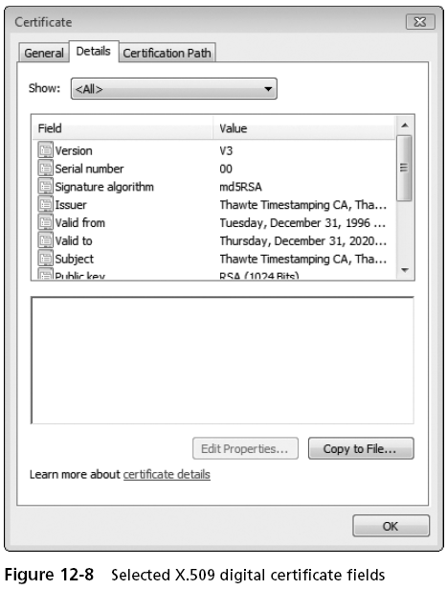
An example of Digital Certificate

Slide 23
The structure of Digital Certificate
X.509v3 Digital Certificate
Version | version 1 | version 2 | version 3
Serial Number
Signature Algorithm Identifier
Issuer Name
Validity Period
Subject Name
Subject Public Key Information
Issuer Unique ID
Subject Unique ID
Extensions
Certification Authority’s Digital Signature

Slide 24
X.509 digital certificate field description
Field | Description
Version | The version number of the X.509 certificate, the current value is 1/2/3
Serial Number | The unique identification number of the certificate generated by the CA
Signature Algorithm Identifier | The algorithm used by the CA to sign digital certificates
Issuer Name | The distinguished name of the CA
Validity(Not Before/Not After) | The validity date of the certificate, at least down to the second
Subject Name | The name of the certificate holder
Subject Public Key Information | Information related to public keys and public key algorithms

Slide 25
Signing and Verification of Digital Certificate
1. CA Certificate
Previously, the X.509 certificate structure was introduced, where the last field is the digital signature of the certificate authority, that is, each digital certificate not only contains user information (such as subject name, public key, etc.), but also contains the digital signature of the certificate authority.
Notes:
The CA's process of signing a digital certificate is shown in next figure.

Slide 26
CA Digital Certificate Process
Digit Certificate Information
Version
Serial
Sig
Message summary Algorithm
Message summary
CA Signature
Digit Signature Algorithm
Private Key
Digit Signature
CA last field
Notes:
在向用户签发数字证书前，CA首先要对证书的所有字段计算一个消息摘要(使用MD5或SHA1等杂凑算法)，而后用CA私钥加密消息摘要(如采用 RSA算法)，构成CA的数字签名。CA将计算出的数字签名作为数字证书的最后一个字段，类似于护照上的印章与签名。该过程由密码运算程序自动完成。

Slide 27
2. Validation of Digital Certificate
Digit Certificate Information
Version
Serial
Sig
Message summary Algorithm
Message summary
MD1
CA Signature
Public Key
Decrypt CA Signature
Equal
No
Invalid
Message summary
MD2
Yes
The certificate is complete
Notes:
数字证书的验证
主要包括如下几步。
(1)用户将数字证书中除最后一个字段以外的所有字段输入消息摘要算法(杂凑算法)。该算法与CA签发证书时使用的杂凑算法相同，CA会在证书中指定签名算法及杂凑算法，令用户知道相应的算法信息。
(2)由消息摘要算法计算数字证书中除最后一个字段外其他字段的消息摘要，设该消息摘要为MD1。
(3)用户从证书中取出CA的数字签名(证书中最后一个字段)。
(4)用户用CA的公钥对CA的数字签名信息进行解密运算。
(5)解密运算后获得CA签名所使用的消息摘要，设为MD2。
(6)用户比较MD1与MD2。若两者相符，即MD1=MD2，则可肯定数字证书已由 CA用其私钥签名，否则用户不信任该证书，将其拒绝

Slide 28
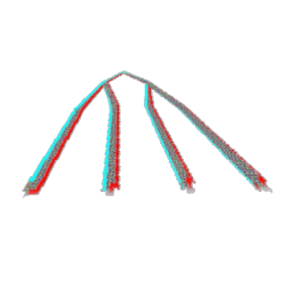
Digital Certificate Hierarchies
Each entity has its own certificate (and may have more than one). The root CA’s certificate is self signed and each sub-CA is signed by its parent CA.
Each CA may also issue CRLs. In particular the lowest level CAs issue CRLs frequently.
End entities need to “find” a certificate path to a CA that they trust.
Root CA
Sub-CAs
End Entities
Notes:
设有两个用户Alice与Bob，希望进行安全通信，在Alice收到Bob的数字证书时，需对该证书进行验证。由前可知，验证证书时需使用颁发该证书的CA的公钥，这就涉及如何获取CA公钥的问题。
每个实体都有自己的证书。根CA是验证链的最后一环，根CA自动作为可信任CA，根CA证书为自签名证书(Self-signed certificate)，即根CA对自己的证书签名，证书的签发者名和主体名均指向根CA。
端点实体需通过信任链(CA层次结构)获取签发证书的CA公钥。

Slide 29
Alice trusts the root CA
Bob sends a message to Alice
Alice needs Bob’s certificate, the certificate of the CA that signed Bob’s certificate, and so on up to the root CA’s self signed certificate.
Alice also needs each CRL for each CA.
Only then can Alice verify that Bob’s certificate is valid and trusted and so verify the Bob’s signature.
Trusted Root
A2
B1
B11
*
Alice
Bob
Notes:
若Alice从三级CA(B1)取得证书，而Bob从另一个三级CA(B11)取得证书。显然，Alice不能直接获取B11的公钥，因此，除了自身证书外，Bob还需向 Alice发送其他上层CA的证书。

Slide 30
Certificate hierarchy and root CA authentication issues
Digit Certificate
…
Issuer Name: Root
Subject Name: Root
Digit Certificate
…
Issuer Name: Root
Subject Name: A2
Digit Certificate
…
Issuer Name: A2
Subject Name: B11
Digit Certificate
…
Issuer Name: B11
Subject Name: Bob
Notes:
第一步：证明Bob数字证书中的公钥是有效的
第二步：需要B11的证书来验证Bob的证书
第三步：获得B11的证书
第四步：需要A3的证书来验证B11的证书
第五步：获得A3的证书
第六步：A3的CA是根CA，Alice信任CA。OK

Slide 31
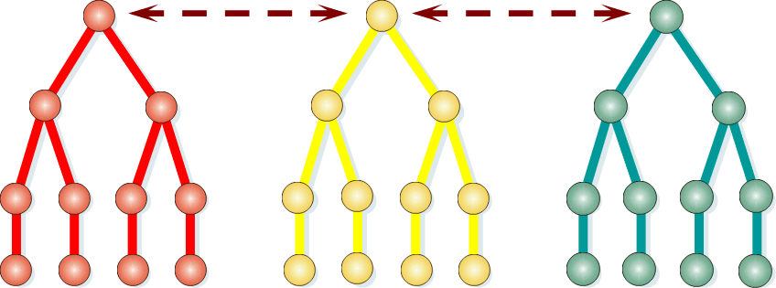
Cross Certificate
Each country has a different root CA, and even the same country may have multiple root CAs. For example, root CAs in the United States are Verisign, Thawte, and the U.S. Postal Service. At this point, not all parties can trust the same root CA. If Alice and Bob are in different countries, that is, when the root CA is different, there is also a trust problem in the root CA.
Notes:
每个国家均拥有不同的根CA，即使同一国家也可能拥有多个根CA。例如，美国的根 CA有Verisign、Thawte和美国邮政局。这时，不是各方都能信任同一个根CA。若Alice与Bob身处不同国家，即根CA不同时，也存在着根CA的信任问题。

Slide 32
Cross Certificate
For the above situation, Cross-certification is used.
It is necessary to use a distributed CA to certify the certificates of various countries, political organizations and companies.
This approach reduces the number of clients served by a single CA while ensuring that the CA can operate independently.
Notes:
针对以上情形，采用交叉证书(Cross—Certification)。由于实际中不可能有一个认证每个用户的统一CA，因此要用分布式CA认证各个国家、政治组织与公司机构的证书。这种方式减少了单个CA的服务对象，同时确保CA可独立运作。此外，交叉证书使不同PKI域的CA和最终用户可以互动。交叉证书是对等CA签发，建立的是非层次信任路径。

Slide 33
Cross Certificate for CA
Chinese Root CA
American root CA
Cross Certificate
Level 2 CA
A1
Level 2 CA
P1
Level 3 CA
B1
Level 3 CA
B2
Level 3 CA
Q1
Level 3 CA
Q2
Alice
Bob
Notes:
如图所示，Alice与Bob的根CA不同，但他们可进行交叉认证，即Alice的根 CA从Bob的根CA那里取得了自身的证书，同样Bob的根CA从Alice的根CA处取得了自己的证书。
尽管Alice的基础软件只信任其自己的根CA，但因为Bob的根CA得到了Alice的根CA的认证，则Alice也可信任Bob的根CA。
利用证书层次、自签名证书和交叉证书技术，令所有用户均可验证其他用户的数字证书，以确定信任证书或拒绝证书。

Slide 34
Revocation of Digital Certificates
Common reasons for digital certificate revocation are:
(1) The holder of the digital certificate reports that the private key corresponding to the public key specified in the certificate has been cracked (stolen);
(2) The CA found that there was an error in issuing the digital certificate;
(3) The certificate holder leaves the company and the certificate was issued during his or her employment
Notes:
数字证书撤销的常见原因有：
①数字证书持有者报告该证书中指定公钥对应的私钥被破解(被盗)；
②CA发现签发数字证书时出错；
③证书持有者离职，而证书为其在职期间签发的。
发生第一种情形需由证书持有者进行证书撤销申请；发生第三种情形时需由组织提出证书撤销申请；发生第二种情形时，CA启动证书撤销。CA在接到证书撤销请求后，首先认证证书撤销请求，然后方接受请求，启动证书撤销，以防止攻击者滥用证书撤销过程撤销他人证书。

Slide 35
Certificate revocation status checking mechanism
Before Alice uses Bob's certificate to communicate securely with Bob, she needs to be clear about the following two things:
(1) Does the certificate belong to Bob?
(2) Is the certificate valid and revoked?
Alice can clarify the first problem through the certificate chain, and clarify the second problem using the certificate revocation status check mechanism.
Notes:
Alice使用Bob的证书与Bob安全通信前，需明确以下两点：
(1)该证书是否属于Bob?
(2)该证书是否有效，是否被撤销?
Alice可通过证书链明确第一个问题，而明确第二个问题则需采用证书撤销状态检查机制。CA提供的证书撤销状态检查机制如图19所示。

Slide 36
Certificate revocation status checking mechanism
Digital certificate revocation check
Offline revocation check
Online revocation check
Certificate Revocation List (CRL)
Online Certificate Status Protocol (OCSP)
Simple Certificate Validation Protocol (SCVP)

Slide 37
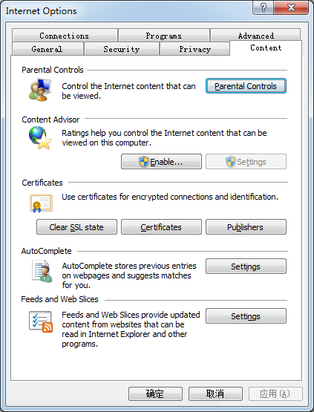
How do I view digital certificates in my system?
Windows7: View the certificate in iexplore
Linux: Look under X.509 certificates
  gcr-viewer test CCB.cer

Slide 38
Thanks!

